Slide 1
FAITH

Slide 2
FAITH
How Would You Define Faith?
Do you have Faith in your everyday life?
Do you believe in places you’ve never been?
Electricity, Magnetism?
Sure, you have FAITH

Slide 3
FAITH
Biblical Uses of “Faith”
Trustworthiness (Faithful servant)
Doctrine of Apostles (THE Faith)
A Personal Belief, Mental Acceptance & Acknowledgement Of God's Existence

Slide 4
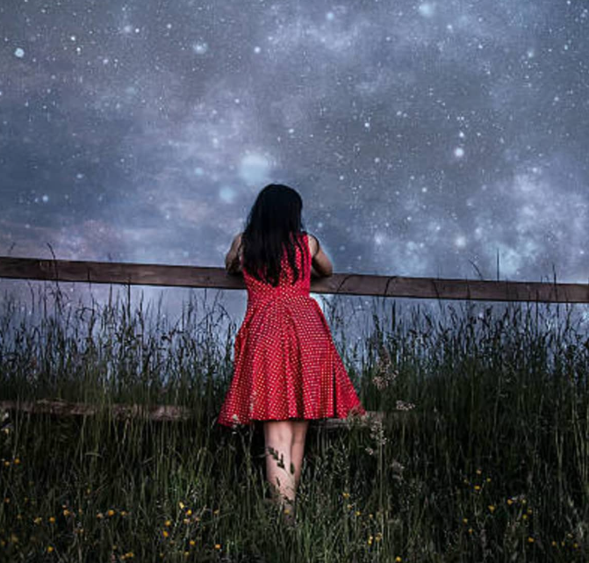
WISH
HOPE
FAITH

Slide 5
FAITH
Now faith is the assurance of things hoped for, the conviction of things not seen.
- Hebrews 11:1

Slide 6
FAITH
How do we develop Faith?
IS SEEING BELIEVING?
John 20:24-28
Yes – sometimes it is
Great for Thomas! But what good does that do me?

Slide 7
FAITH
HEARING is BELIEVING!
But not for everyone
John 4:46-48
“Unless you see signs & wonders you will not believe”
The organ of faith is not the eye, but the ears.

Slide 8
FAITH
IS SEEING BELIEVING?
“If I could just see Jesus, I would believe in Him”
Luke 16:27-31
Even if someone could witness resurrection from the dead!

Slide 9
FAITH
HEARING is BELIEVING!
John 4:39-42
Why did they believe?
Did you read of any miracles in the village?
They HEARD Jesus’ Words

Slide 10
FAITH
HEARING is BELIEVING!
1 Corinthians 1:20-25
Wanted signs
Wanted wisdom
What did they preach?

Slide 11
FAITH
HEARING is BELIEVING!
John 12:32
What makes men believe?

Slide 12
FAITH
So why DID/DOES the WORLD NOT BELIEVE?
John 7:1-7
Jesus taught what they didn’t want to hear (and still don’t want to hear)
Their unbelief was not based on reason but rebellion.
Do you think the world just doesn’t want to believe?

Slide 13
FAITH
Reasons why WORLD does NOT BELIEVE (per the interweb)
Think there is no evidence the ‘story’ is real
Grew up in Faithless Family – never taught
Lost their Faith
Experiences at College
Intellectual Challenges

Slide 14
FAITH
Same Message : Different Responses
Acts 2:37
Acts 5:29-33
Acts 7:52-54

Slide 15
John 20:29-31
Jesus said to him, “Have you believed because you have seen me? Blessed are those who have not seen and yet have believed.”
Now Jesus did many other signs in the presence of the disciples, which are not written in this book; but these are written so that you may believe that Jesus is the Christ, the Son of God, and that by believing you may have life in his name.
FAITH

Slide 16
Types of FAITH
Unwavering Faith – Heb. 10:23
Great Faith – Matt. 8:8-10
Strong Faith – Romans 4:20
Active Faith – Mark 5:25-34
Growing Faith – 1 Thess. 1:3
Measure of Faith – Romans 12:3
Genuine Faith – 2 Tim. 1:5
Common Faith – Titus 1:4
Wavering Faith – James 1:5-7
Weak Faith – Romans 14-15
Little Faith – Matt. 6:30
Dead Faith – James 2:17

Slide 18
FAITH & WORKS
Eph. 2:8-9; Gal. 2:16
James 2:14-17
Romans 1:5; 1 Thess 1:2-3

Slide 19
FAITH & WORKS
If you really believe Jesus is the Christ and that he is Lord, it changes the way you live.
So Faith is partially about belief but it is more than that. It is that belief moved into action.

Slide 20
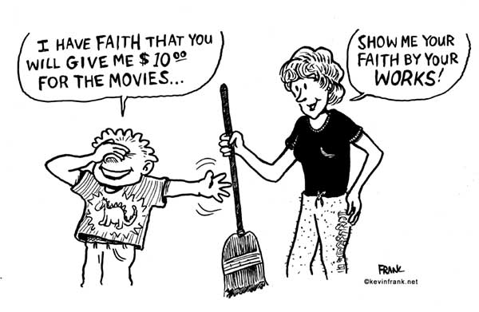
FAITH & WORKS

Slide 21
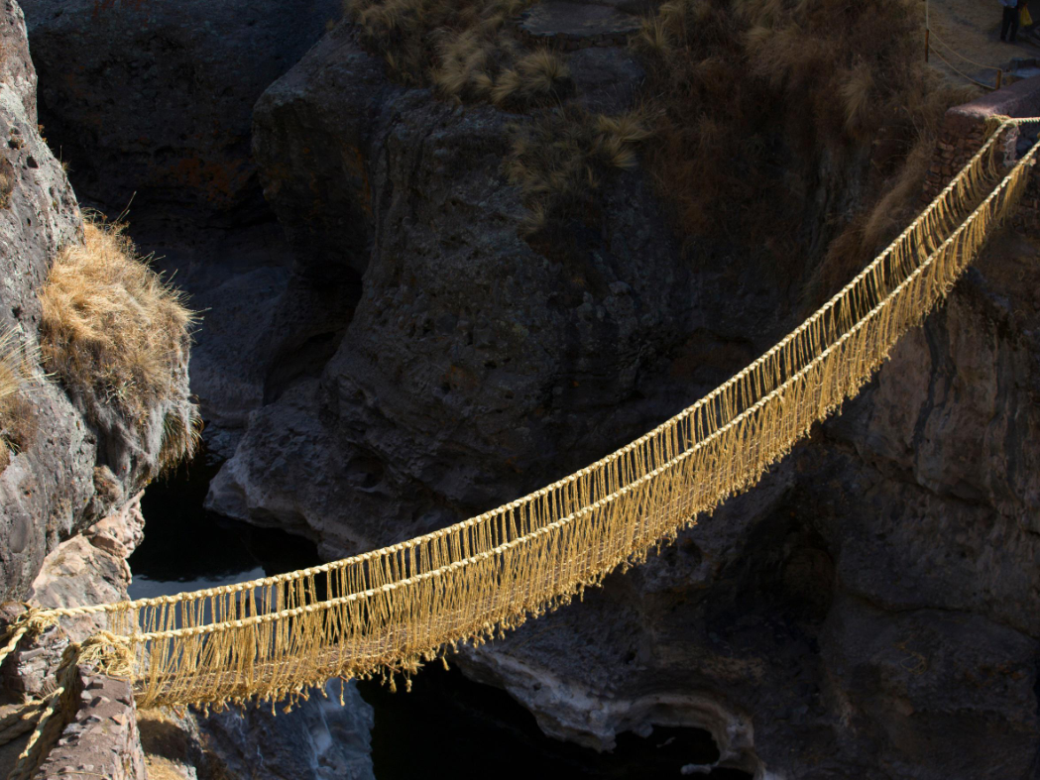

Slide 22
FAITH
What is your definition of Faith now? Different?
Faith is living as if what God has said it true!

Slide 23
Dead Faith vs. Living Faith
What makes our Faith Living or Dead?
Works prove our Faith is alive
Lack of Works show our Faith is dead

